Slide 1
Adult Salary Prediction
Presented by:
Omran Fallatah
Ghanim Alghanim

Slide 2
Dataset

Slide 3
Dataset Description
The dataset is credited to Ronny Kohavi and Barry Becker and was drawn from the 1994 United States Census Bureau data and involves using personal details such as education level to predict whether an individual will earn more or less than $50,000 per year.
The task is to predict whether a given adult makes more than $50,000 a year-based attributes such as education, hours of work per week, etc.

Slide 4
Dataset
The dataset was collected from UCI machine learning repository
The dataset provides ~50,000 observations and 14 input variables that are a mixture of categorical, ordinal, and numerical data types. The complete list of variables is as follows:
Age.
Workclass.
Final Weight.
Education.
Education Number of Years.
Marital-status.
Occupation.
Relationship.
Race.
Sex.
Capital-gain.
Capital-loss.
Hours-per-week.
Native-country.
Target filed: Income

Slide 5
EDA

Slide 6
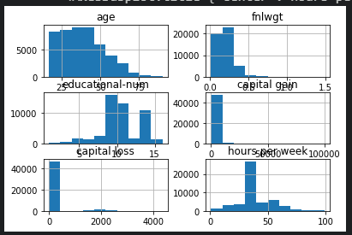
Exploratory Data Analysis
We can see many different distributions, some with Gaussian-like distributions, others with seemingly exponential or discrete distributions. We can also see that they all appear to have a very different scale.
Depending on the choice of modeling algorithms, we would expect scaling the distributions to the same range to be useful, and perhaps the use of some power transforms

Slide 7
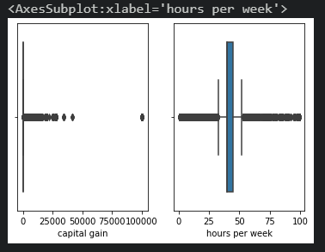
Data Cleaning & Feature Engineering
A lot of outliers
Convert categorical into maps and one hot encoding
Dropping missing data that can’t be filled due to lack of data.

Slide 8
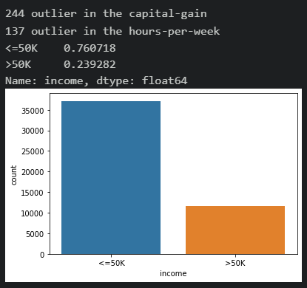
Pre-Model Fitting
Unbalanced data
Used SMOTE to fill the least filled target
Used MinMaxScaler to normalize the data

Slide 9
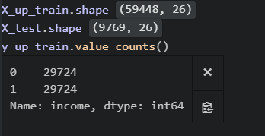
Pre-Model Fitting
Our model now consists of ~69000 observation
split into 2 arrays one for training and testing : ration 80/20 % respectively
Scaled between 0-1

Slide 10
Models

Slide 11
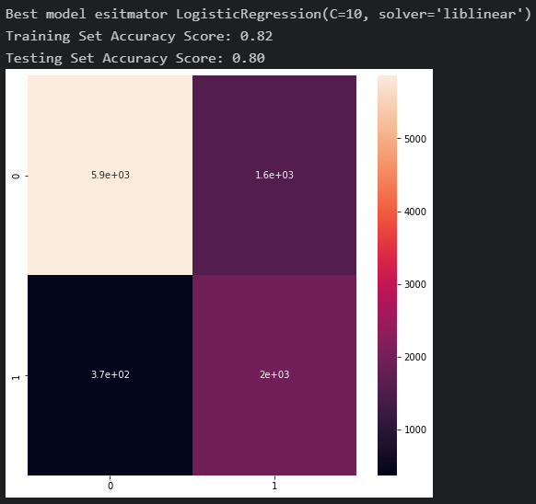
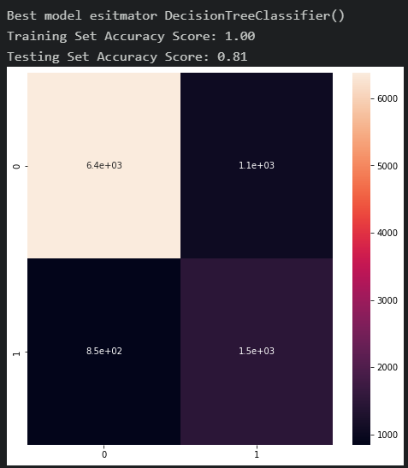
Logistic Regression Decision Tree

Slide 12
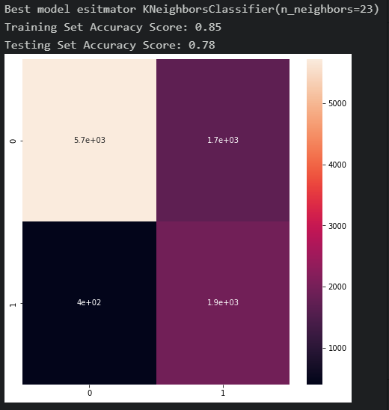
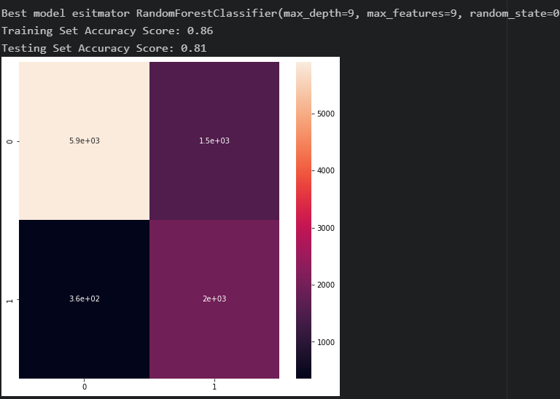
Random Forest K-Nearest Neighbors

Slide 13
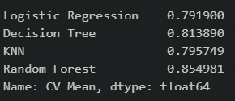
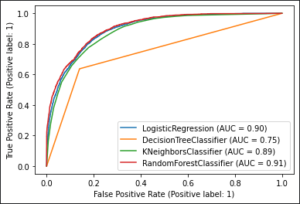
Cross Validation with 10 K folds
Best Model is Random Forest
with best R Squared Score 0.85

Slide 14
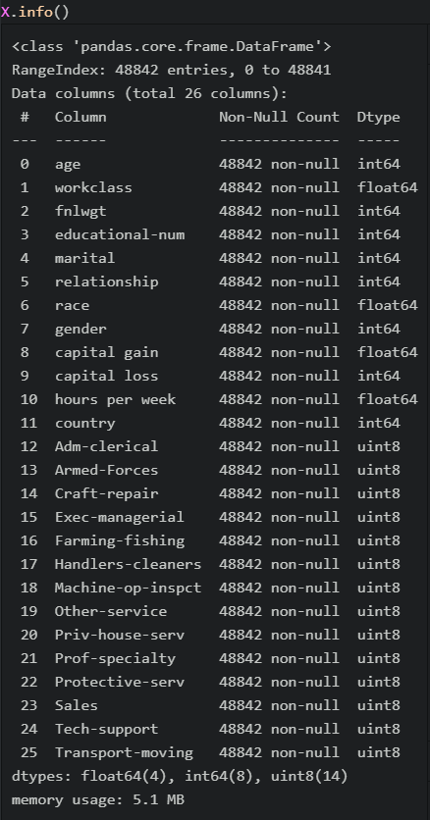
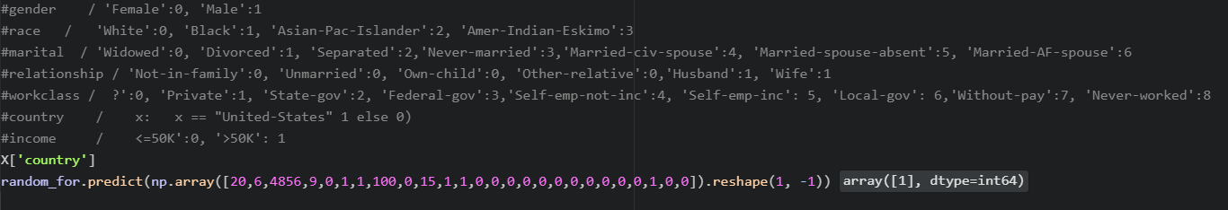
Prediction example

Slide 15

Thank you
Questions ?

